Slide 1

Project 1
Group 7
Brought to you by:
Armin Ghasemian
Cameron Seibel
Eileen Mitchell
Kim Moran
OpenBreweryDB and UselessFacts API for Group Project 1

Slide 2
Allows a user to search for thousands of breweries by city.
Directions to any brewery are easily available and linked to the webpage.
Favorite breweries can be saved to be referred to later.
Displays useless facts that will allow you to strike up engaging conversation at any brewery you visit.

Slide 3
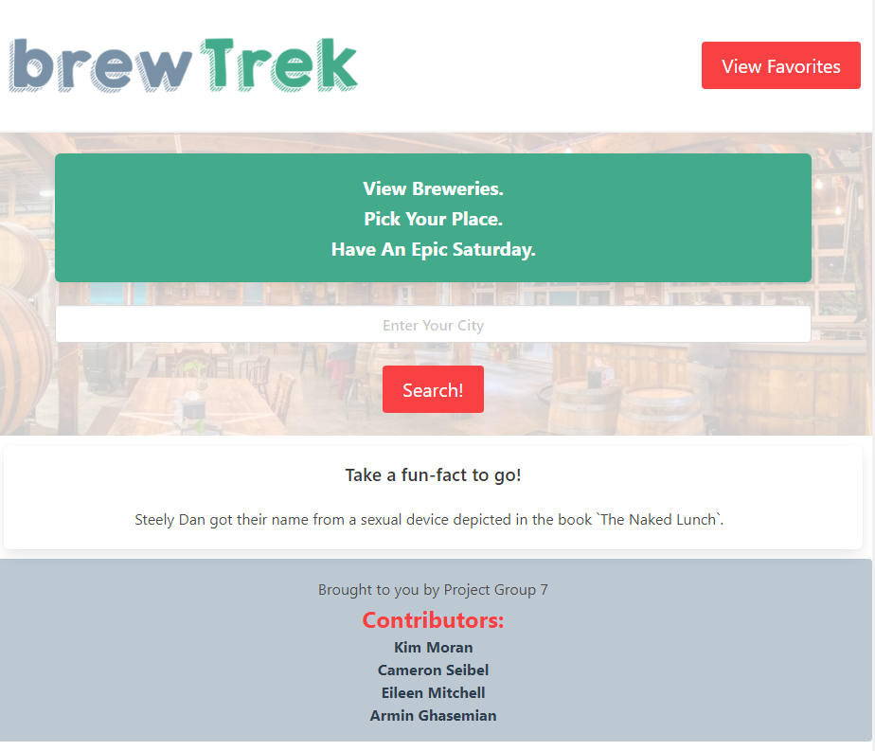
As a person who enjoys social activities,
I want to view nearby breweries and some useless facts,
So I can plan an outing for the day.

Slide 4
When I enter the main page, I am presented with a fun-fact at the bottom of the page, an option to view my favorites, and an option to search for a city.
When I enter a city then I am presented with brewery names, address (with map links), and a button to add any single brewery as a favorite.
When I click on a brewery, then I am presented with brewery name, website, phone, address, link to google maps, and option to add as a favorite.
When I click the “brewTrek” logo or ‘back’ button, I am taken back home.
When I click on View Favorites, I see my favorited breweries and can click on the name to get detailed information again.

Slide 5

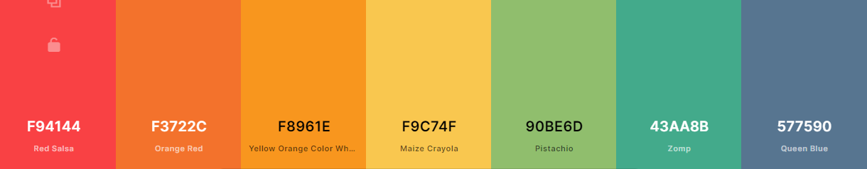

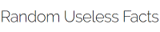





How did we do it?

Slide 6
Who did what?
Home page
Search bar
Fun Facts
Footer

Slide 7
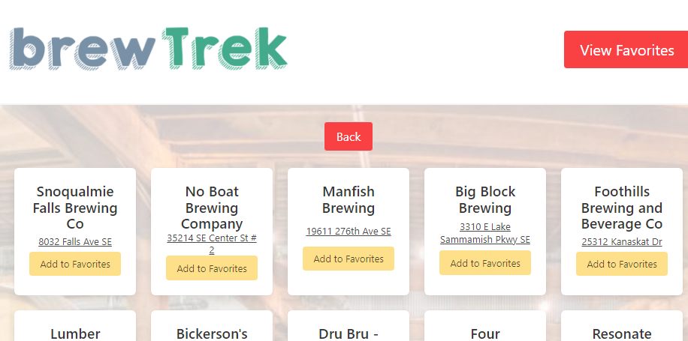
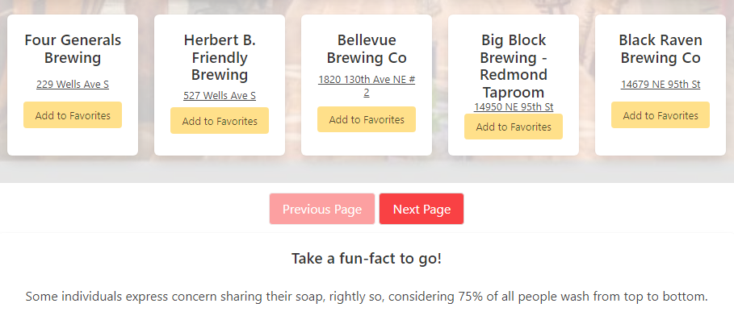
Who did what?
Breweries Display +
Multiple Pages

Slide 8
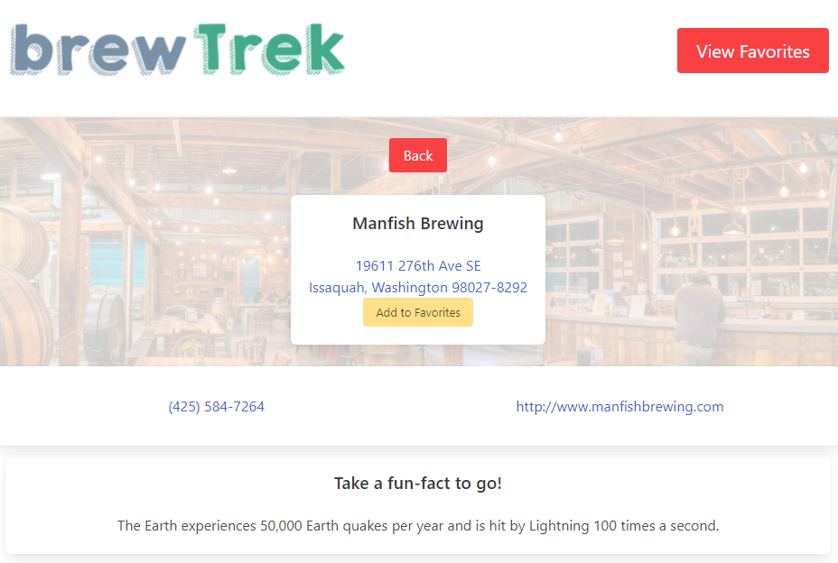
Who did what?
Single Brewery Page:
Maps
Facts
Links

Slide 9
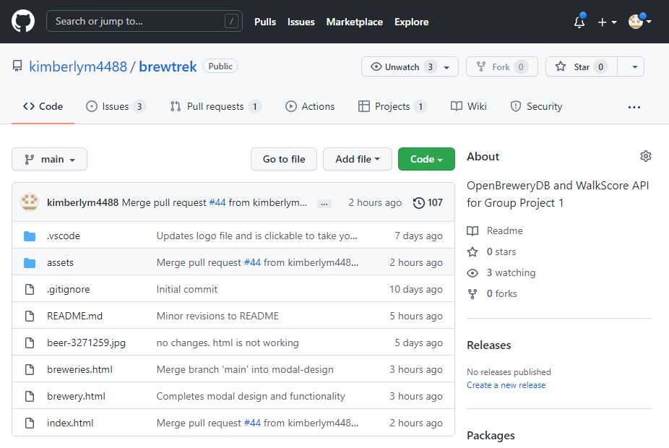
See the code in action!
Live page:
https://kimberlym4488.github.io/brewtrek/
GitHub Files:
https://github.com/kimberlym4488/brewtrek

Slide 10

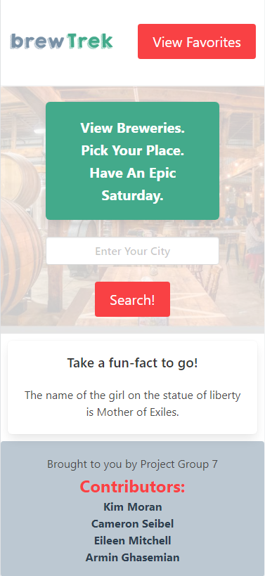
What’s next for brewTrek?
Links to food pairing with beers?
Theme colors for each season of the year?
Walking score for each location?

